Slide 1

Comments
Clean Code – Chapter 4

Slide 2
Introduction
“Don’t’ comment bad code – rewrite it”.
Comments are not “pure good”.
Comments are, at best, a necessary evil.
The proper use of comments is to compensate for our failure to express ourselves through code.
Comments can’t always follow the code changes.

Slide 3
Introduction (cont.)
It’s better put the energy of writing code into making the code itself so clear and expressive that it doesn’t need the comments in the first place.
Inaccurate comments are far worse than no comments at all.
Truth can be found in one place: the code.

Slide 4
Comments Do Not Make Up for Bad Code
One of the more common motivations for writing code is bad code.
“Ooh, I’d better comment that” => No! You’d better clean it!
Clear and expressive code with few comments is far superior to cluttered and complex code with lots of comments.

Slide 5


Explain Yourself in Code
There are certainly times when code makes a poor vehicle for explanation.
Unfortunately, many programmers have taken this to mean that code is seldom, if ever, a good means for explanation.
This id patently false.
In many cases it’s simply a matter of creating a function that says the same thing as the comment you want to write.

Slide 6
Good Comments
Some comments are necessary of beneficial.
However, that the only truly good comment is the comment you found a way not to write.

Slide 7
Good Comments – Legal Comments
Copyright and authorship statements are necessary and reasonable things to put into a comment at the start of each source file.
Comments like this should not be contracts or legal tomes.
Where possible, refer to a standard license or other external document rather than putting all the terms and conditions into the comment.

Slide 8


Good Comments – Informative Comments
It’s sometimes useful to provide basic information with a comment.
For example:
But it’s better to use the name of the function to convey the information where possible => responderBeingTested.
Another example:
It might have been better, and clearer, if this code had been moved to a special class that converted the formats of dates and times.

Slide 9
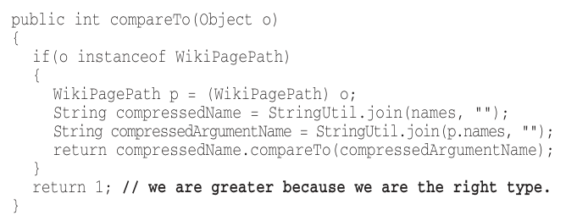
Good Comments – Explanation of Intent
Sometimes a comment goes beyond just useful information about the implementation and provides the intent behind a decision.

Slide 10
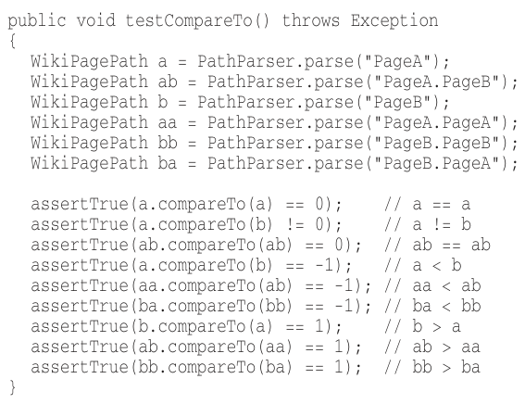
Good Comments – Clarification
Sometimes it’s just helpful to translate the meaning of some obscure argument or return value into something that’s readable.
It’s better to find a way to make that argument or return value clear in its own right.
But when it’s part of the standard library,
or in code that you can’t alter,
then a helpful clarifying comment
can be useful.

Slide 11
Good Comments – Warning of Consequences
Sometimes it’s useful to warn other programmers about certain consequences.
In the past, putting an underscore in front of the method name was a common convention.
Nowadays, we’d turn off the test case by using @Ignore attribute with an appropriate explanatory string.

Slide 12
Good Comments – TODO Comments
TODOs are jobs that the programmer thinks should be done, but for some reason can’t do at the moment.
It might be:
remainder to delete a deprecated feature or a plea for someone else to look at a problem.
a request for someone else to think of a better name.
a remainder to make a change that is dependent on a planned event.
It’s not a an excuse to leave bad code in the system.

Slide 13
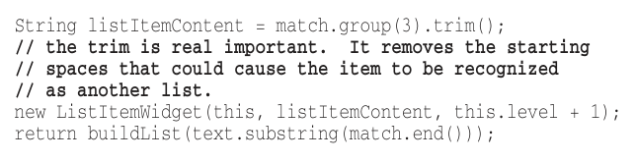
Good Comments – Amplification
A comment may be used to amplify the importance of something that may otherwise seem inconsequential.

Slide 14
Good Comments – Javadocs in Public APIs
If you are writing a public API, then you should certainly write good javadocs for it.
But javadocs can be just as misleading, nonlocal, and dishonest as nay other kind of comment.

Slide 15
Bad Comments
Most comments fall into this category “bad”.
Usually, they are crutches or excuses for poor code or justifications for insufficient decisions, amounting to little more than the programmer talking to himself.

Slide 16
Bad Comments – Mumbling
If you decide to write a comment, then spend the time necessary to make sure it’s the best comment you can write.
Any comment that forces you to look in another module for the meaning of that comment has failed to communicate to you and isn’t worth the bits it consumes.

Slide 17
Bad Comment – Redundant Comments
The comment probably takes longer to read than the code itself.
It doesn’t justify the code or provide intent or rationale.
These comments serve only to clutter and obscure the code.

Slide 18
Bad Comment – Misleading Comments
Sometimes, with all the best intentions, a programmer makes a statement in his comments that isn’t precise enough to be accurate.

